Slide 1
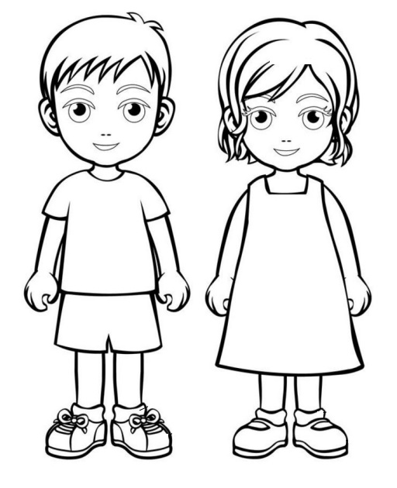
BODY PARTS

Slide 2
hair
ear
head
eye
mouth
nose
arm
finger
hand
leg
foot

Slide 3
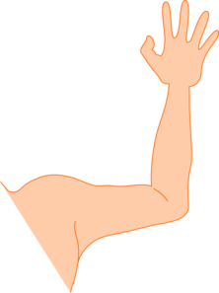
What is this?
arm
foot
leg

Slide 4
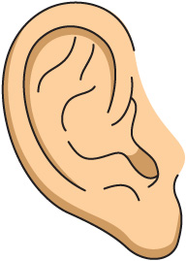
What is this?
leg
nose
ear

Slide 5
What is this?
ear
finger
hand

Slide 6
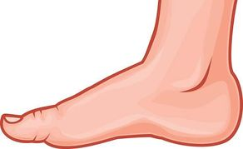
What is this?
head
foot
hand

Slide 7
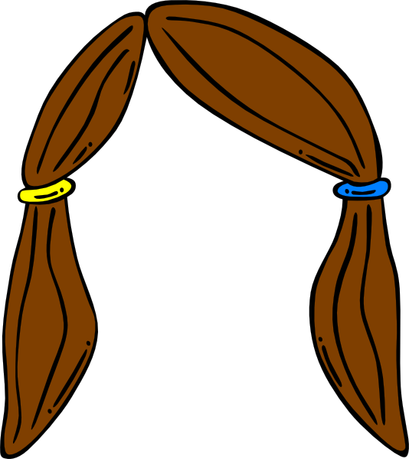
What is this?
hair
head
nose

Slide 8
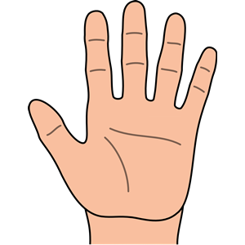
What is this?
foot
hand
nose

Slide 9
What is this?
mouth
ear
head

Slide 10
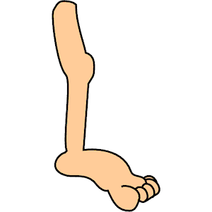
What is this?
nose
leg
hand

Slide 11
What is this?
foot
ear
mouth

Slide 12
What is this?
nose
hair
ear

Slide 13
What is this?
eye
head
foot

